Slide 1
Mix That Tweet
Henry Fellerhoff, Brian Nguyen, Sophie Von Hatten

Slide 2
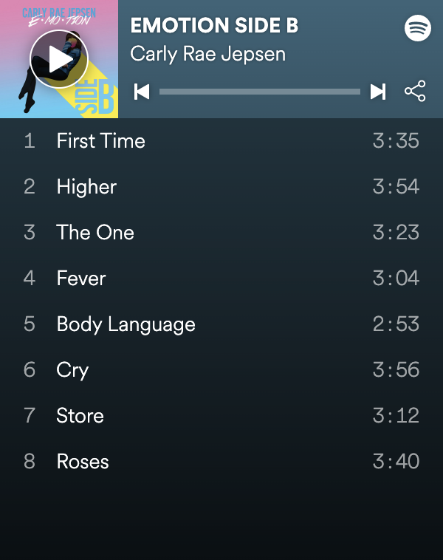

The System
Flask
MySQL Server

Slide 3
The Mission
This project is being developed for Twitter and Spotify
The mission of these companies with regard to this project is to showcase the capabilities and ease-of-use of their APIs for third-party developers
Both companies do business in the social media, music, and data industries

Slide 4
Project Scope
“Problem”:
Finding unique and creative ways to generate playlists of songs
Overall goal:
The project is meant to generate a playlist of 10 songs based on natural language sentiment values analyzed on a given tweet. This can provide users with a creative means to finding new music, bridging a gap between two forms of self expression.
Subsystem boundaries:
User management system: Handling user data and playlists was not one of the goals of this project, but rather just gathering songs that expressed a Tweet for the user to gather a reaction and build viralability.
Users:
Twitter and Spotify users

Slide 5
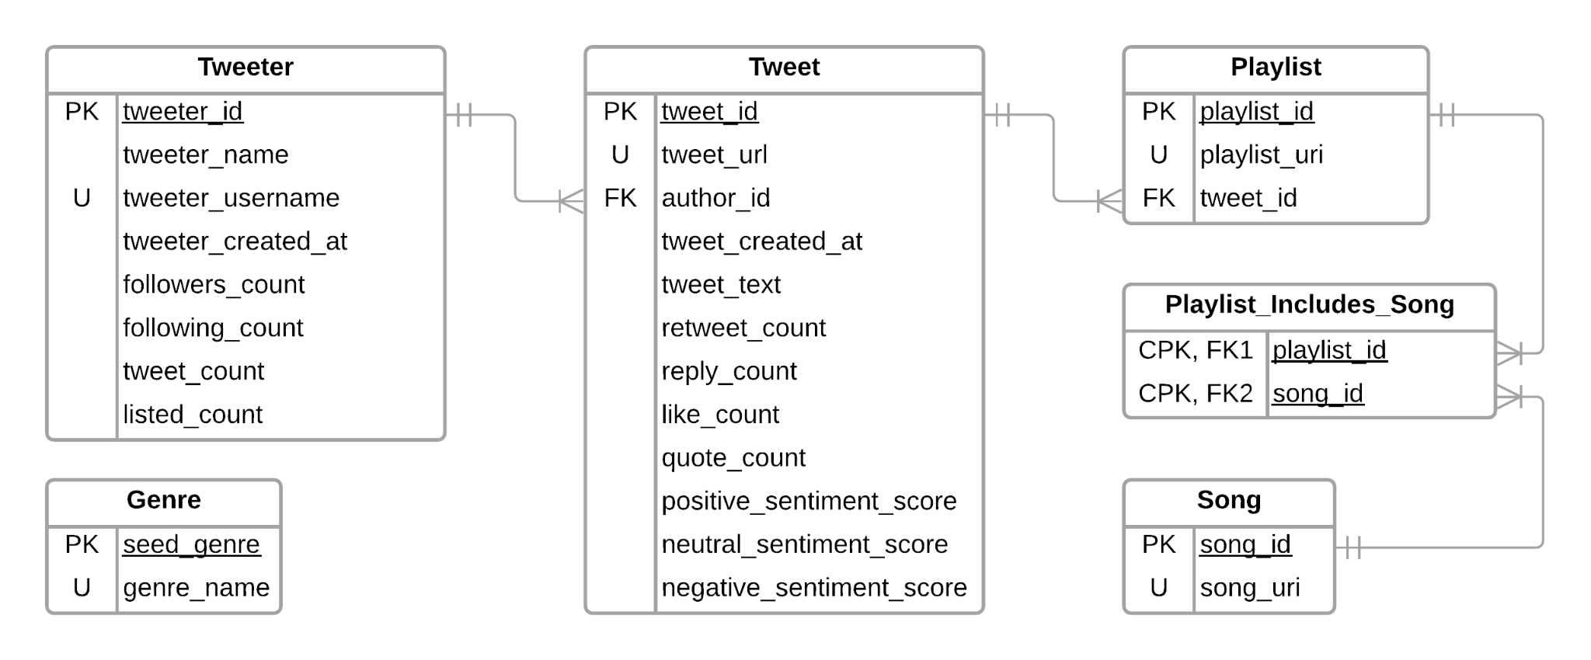
Database Design

Slide 6
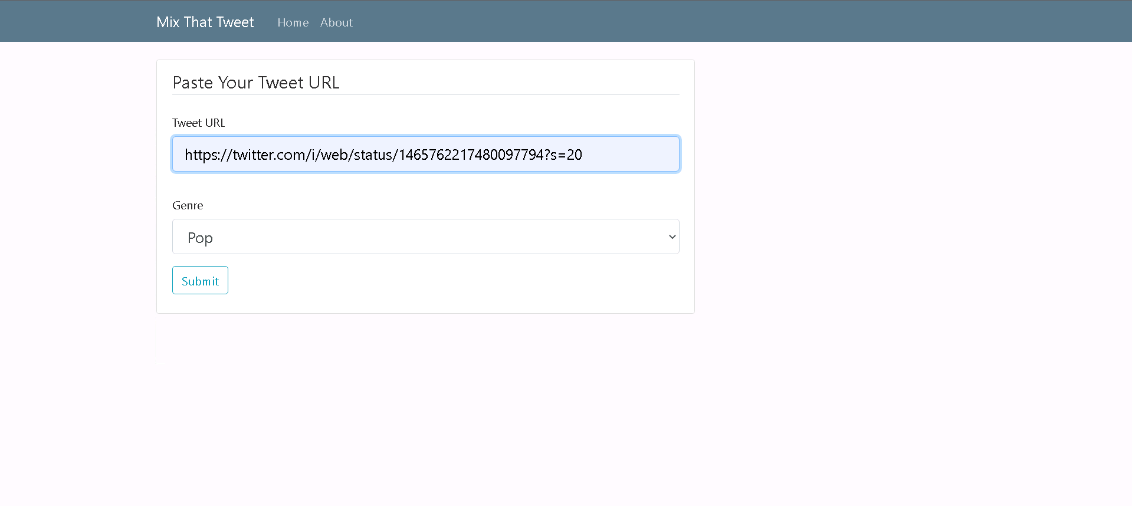
Project Demonstration & Screenshots

Slide 7
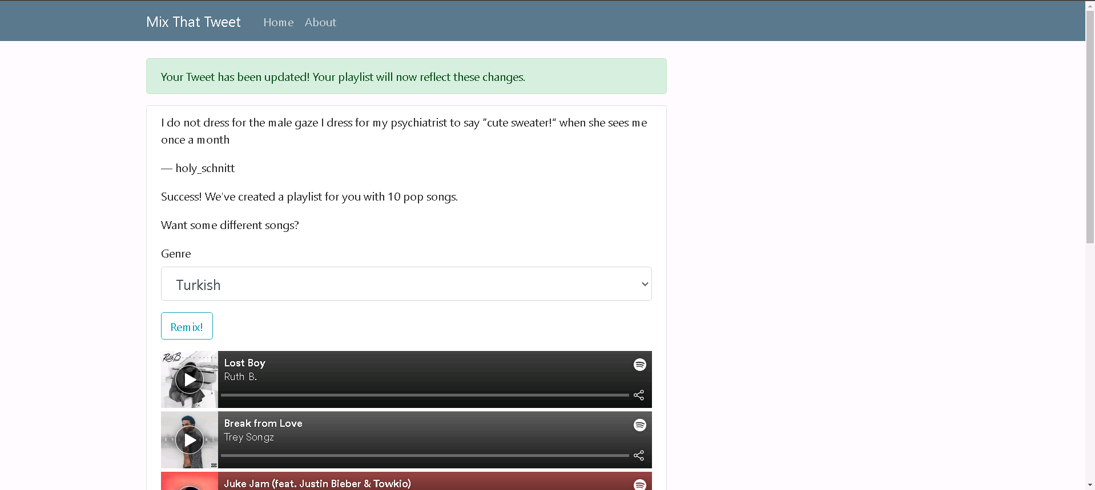

Slide 8
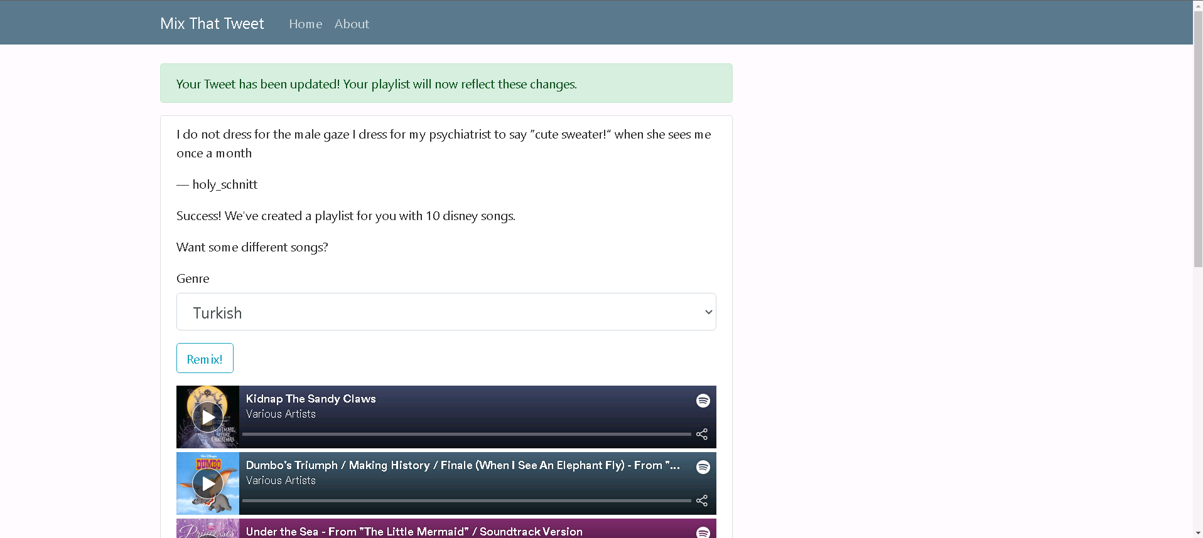

Slide 9
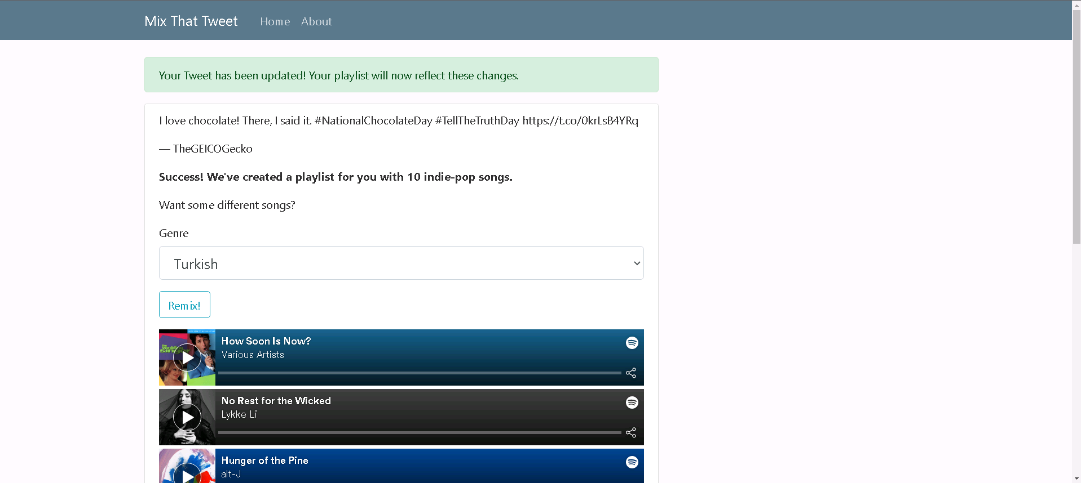

Slide 10
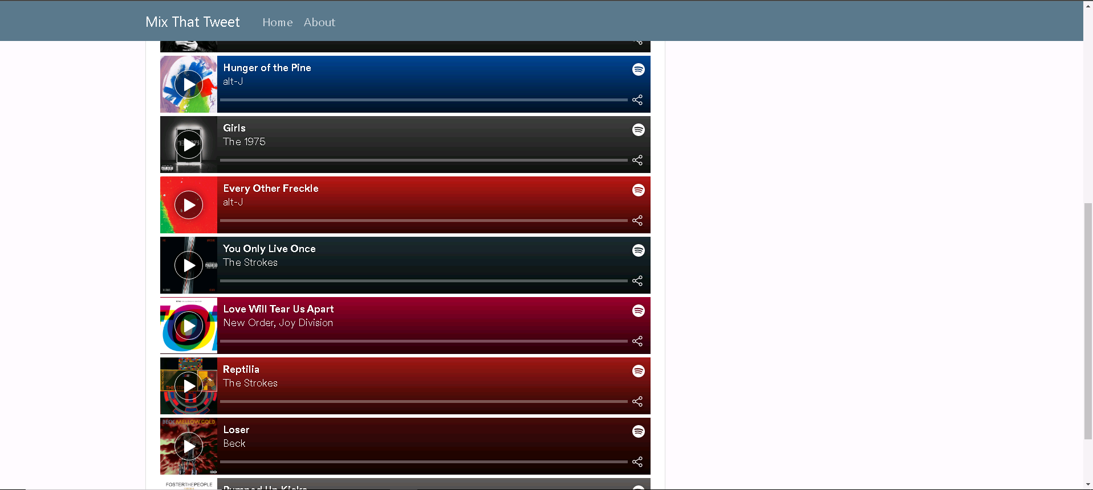

Slide 11
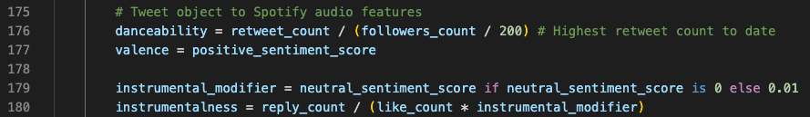
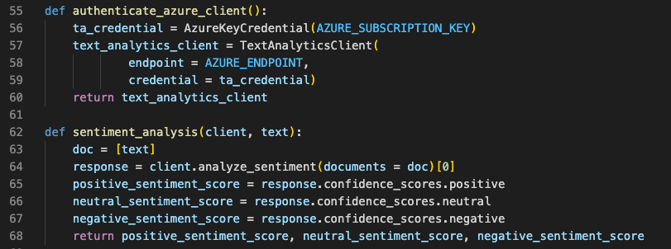
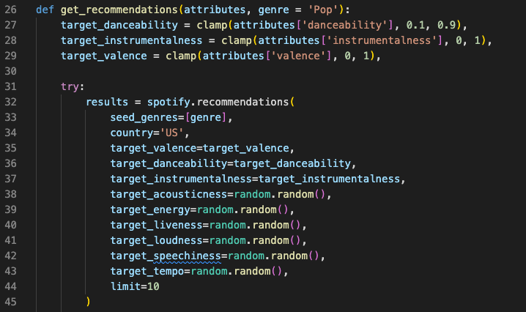
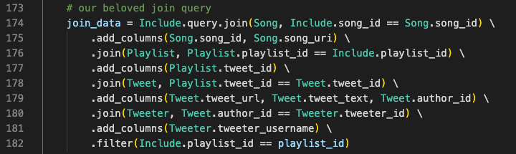
Code Sample

Slide 12
Interaction With Database
C
All tables are created using the project initialization SQL files
R
Data in tables are read in the Flask app to access Tweet data and generate songs in a playlist
U
Data in tables are updated in the Flask app as a user inputs a pre-existing Tweet or the playlist ‘Remix’ button is selected
D
Data of pre-existing songs in tables are deleted from the currently-generated playlist and the other playlist that include them

Slide 13
How We Solve The “Problem” Addressed
The application allows for users to input a tweet they have seen, and come out with a generated playlist of songs that represent the sentiment values analyzed from that given tweet.
This represents the use of two APIs from different platforms meant for self expression, and finding a way to bridge the gap between the two.
Users can enjoy the unique qualities that both Twitter and Spotify have to offer.

